Slide 2
Intelligent Apps Using Cognitive Services
Michael Lanzetta
Principal SDE

Slide 3
Session Goals
Cognitive Services
Overview of Microsoft Cognitive Services Suite
Focus on Vision and LUIS
Azure Services
DocumentDB – a Great NoSQL PaaS Store
Azure Search – Intelligent PaaS Search on your own data
Bot Framework
Integrating Azure Search and LUIS
Working Code!
Finish the day with working code you can build upon
Notes:
This slide is required. Do NOT delete. This should be the first slide after your Title Slide.
This slide should describe what your goals are for this session. This information lets your audience know what you are trying to accomplish with your talk or tutorial—ie, what value will attendees get by investing 25 minutes or 2 hours of their time listening to you.
You should not spend more than 1 minute presenting this slide.
General examples of session goals could be (you will have to create your own specific goals):
Introduce a new technique or approach to solve a customer problem
Compare two approaches and explain why one is superior
Describe a project and the learnings that audience members can apply from it
Teach audience members how to use a specific technology

Slide 4
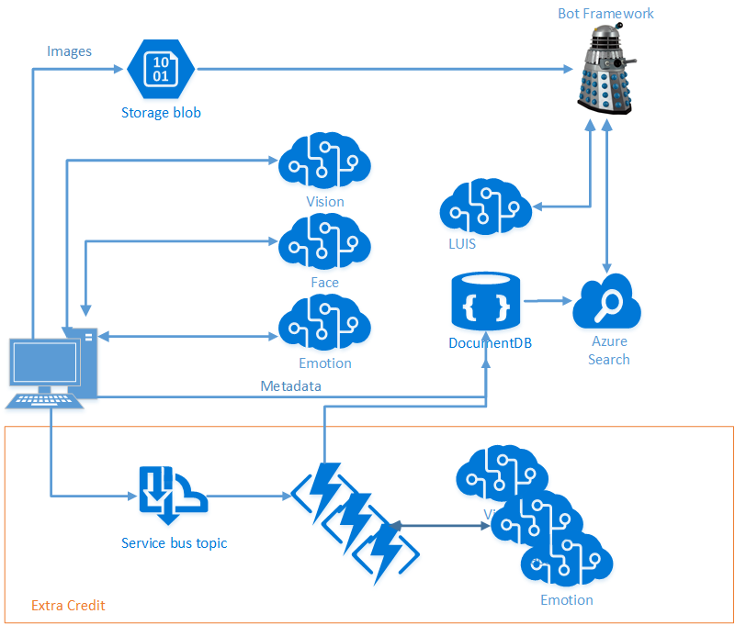
Scenario
Intelligence from Images
Vision Services
Cloud Storage
Search
Conversation and Language Understanding

Slide 5
Agenda
Overview and Scenario
Phase 1 – 11:00 – 1:45
Tour of the Cognitive Services and DocumentDB
Hands-on – Calling Vision Services, Writing to DocumentDB
Phase 2 – 1:45 – 3:00
Tour of Azure Search
Hands-on –Building and Querying an Index
Phase 3 – 3:00 – 5:00
Tour of the Bot Framework
Hands-on – Building a Query Bot
Concluding Remarks

Slide 6
Setup
Azure Pass
Take a look at your Azure Pass guide
Log into Portal
Visual Studio: Don’t have it? Deploy a VM!
Code
Go to our GitHub Repo: https://github.com/noodlefrenzy/CognitiveServicesTutorial
Clone Locally
Load up LabManual.md
Code for all tracks is available at: https://github.com/Microsoft/AI-Immersion-Workshop

Slide 7
Code Repository Structure
LabManual.md has all directions
“Starting” directory has “boilerplate” code
Too much to do in one day, so we’ve done the annoying bits
Once you’re home, feel free to start from scratch – we accept PRs ☺
“Finished” directory has completed code
Useful to correct your direction
Feel free to pull from this if you start running behind
“sample_images.zip” contains some samples for use
Feel free to use your own

Slide 9
Setup
Azure Pass
Take a look at your Azure Pass guide
Log into Portal
Visual Studio: Don’t have it? Deploy a VM!
Code
Go to our GitHub Repo: https://github.com/noodlefrenzy/CognitiveServicesTutorial
Intelligent Kiosk: https://github.com/Microsoft/Cognitive-Samples-IntelligentKiosk
Playground
Cognitive: https://azure.microsoft.com/en-us/services/cognitive-services/
DocumentDB: https://www.documentdb.com/sql/demo

Slide 11
Azure Search
Liam Cavanagh (@liamca)
Principal Program Manager

Slide 12

What is Azure Search?
A search-as-a-service solution allowing developers to incorporate great search experiences into applications without managing infrastructure or needing to become search experts.
“Simplify the Search Experience”

Slide 13
Why?
Developers look for PaaS services in Azure to achieve better results faster in their apps
Search is key to many categories of applications
Web search engines have set the bar high for search
Instant results, auto-complete, hit highlighting, great ranking, linguistics
Search is hard and rarely a core expertise area
Infrastructure standpoint: availability, durability, scale, operations
Functionality standpoint: ranking, language support, geo-spatial

Slide 14
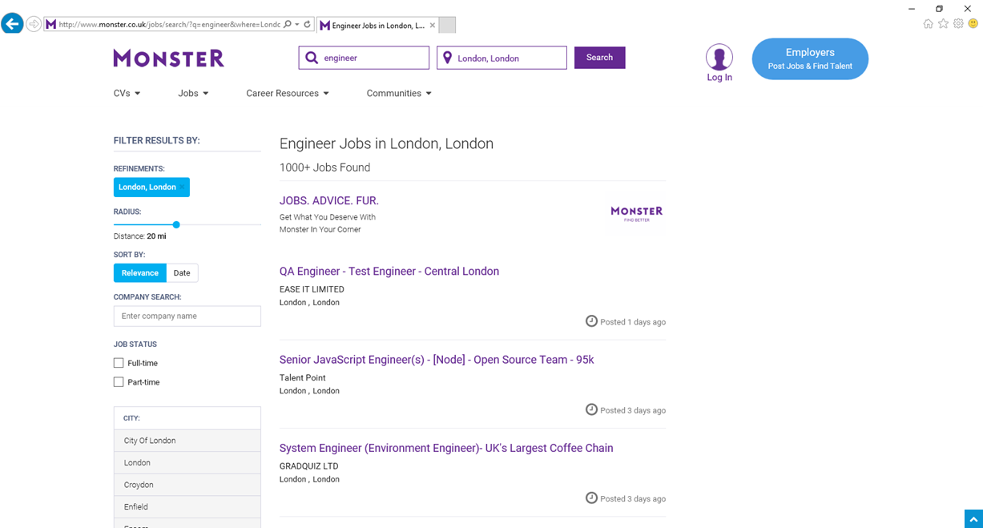
Sorting
Ranking
Facets

Slide 15
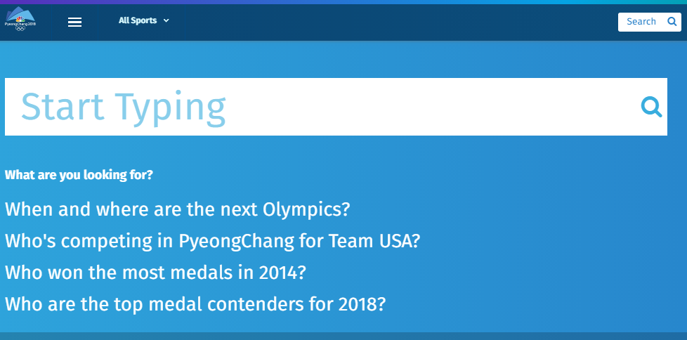
Type Ahead and Search Suggestions

Slide 16
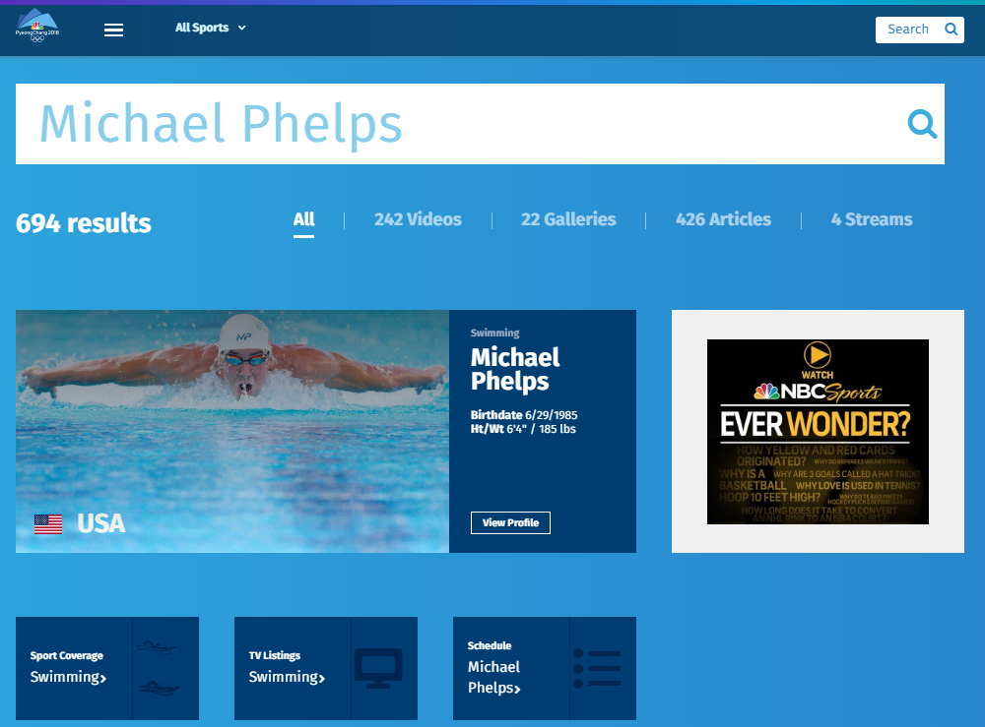
Facets
Tuning
Recommendations

Slide 17
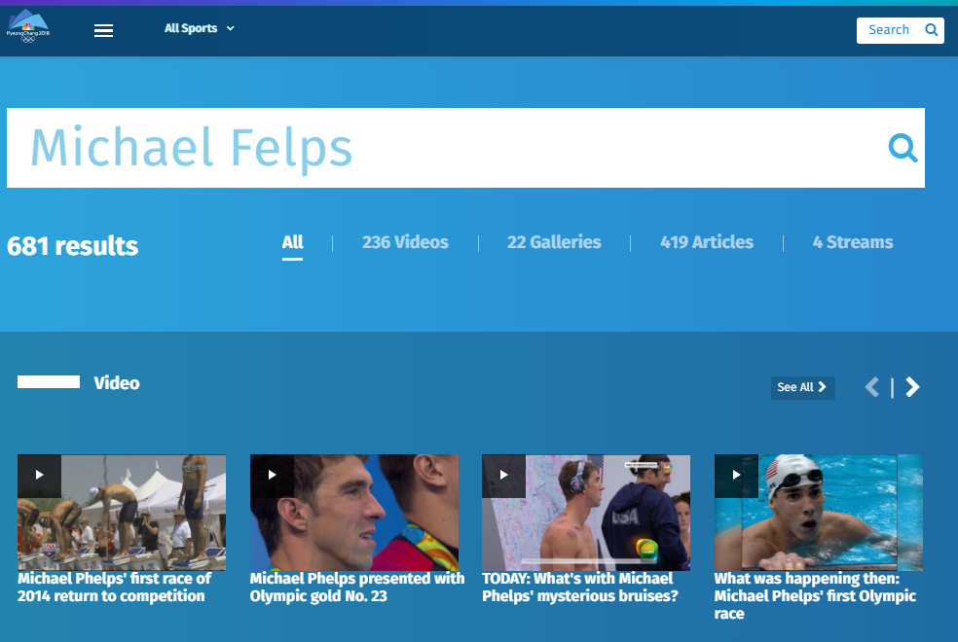
Spelling Mistakes

Slide 18
Typical Workflow
Provision service
Create index
Index data
Search

Slide 19
“Search service”
Scope for capacity
Bound to a region
Has keys, indexes, indexers, data sources
Provisioning
Azure Portal
Azure resource management API
Elastic scale
Capacity can be changed dynamically
Replicas ~ more QPS, HA
Partitions ~ more documents, write throughput
Provision service
Create index
Index data
Search

Slide 20
“Index”
Container for data, think “table”
Has schema, CORS options, search options
Create in portal or during app initialization
Typical schema
Fields definition: name, type, key
Search specifics
Field attributes – searchable, facetable, etc.
Linguistics and analysis
Suggesters for auto-complete
Scoring profiles for ranking tuning
Provision service
Create index
Index data
Search

Slide 21
Push - using indexing API
POST to /indexes/<name>/docs/index
Up to 1000 actions per batch
Actions can be upload, merge, delete, etc.
Pull - using indexers
Azure SQL DB, DocumentDB, Blob and Tables
Change detection, deletion markers
Point it at the data source, define policy, done
Provision service
Create index
Index data
Search

Slide 22
Search + typical data operations
Simple search options, + - * () “”
Filter, sort, project, page over results
Spelling mistakes, phonetic and RegEx
Options work with search and suggest
Search from client or server
Use query keys when searching from clients
CORS allows direct calls from browsers
Render from search results
Include necessary non-searchable data
E.g. URLs for pictures, keys to main content
Provision service
Create index
Index data
Search

Slide 23
Linguistics
Linguistics are key in search
Support for 56 languages
Word breaking, stop words, inflections
Lucene analyzers
Well-known analyzer stack
Stemming
Microsoft analyzers
Same NLP stack used by parts of Office, Bing
Deep understanding of languages
Lemmatization in many languages

Slide 24
Custom relevance
Scoring profiles
Field weights
Scoring functions
magnitude, freshness, distance, tags
3 main patterns
Known data directly available in the index
Personalization using tag boosting
Analytics, compute externally and push to the index

Slide 25
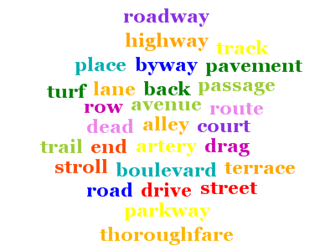
Synonyms (Preview)
Associate equivalent terms that implicitly expand the scope of a query, without user having to actually provide terms. For example:
"dog" can be associated with “canine” & “puppy”
Synonyms are currently in preview, exclusive to the Service REST API (api-version=2015-20-28-preview)
Word mappings is defined in a “synonym map” and is linked to one or more Index fields using synonymMaps in the field definition
Synonyms can be updated as needed
Ties in well with Search Traffic Analytics (Searches with 0 Results)

Slide 28
The Bot Framework
Jennifer Marsman
Principal Software Development Engineer
Microsoft Corporation
http://blogs.msdn.microsoft.com/jennifer
Twitter: @JenniferMarsman

Slide 29
Session Goals
Learn how to build bots (the coding stuff)
Learn how to build *good* bots (the design stuff)

Slide 30
Agenda
Bot Framework Architecture and Channels
Dialogs
State Service
Form Flow
QnA Maker
Scorable Groups
Bot Design
Resources

Slide 31

Architecture of a typical bot
Conversation Canvas/Channels
Web Chat
Your code goes here
Email
Bot Connector Service
Facebook
Message input <> output
State Management
GroupMe
Your bot code
Kik
Bot Builder SDK
Skype
Slack
Bot Builder SDK
API, SDK calls
Telegram
+ Intelligent Services
Twilio (SMS)
Other services, APIs,
Databases, Azure Machine Learning, Azure Search, etc…
Natural Language
Translation
Bot Clipboard w entities
User Preferences
Teams
…
Direct Line…
Speech
Entity Extraction
Bing Knowledge
Image Intelligence
…
…
…
Notes:
Talk about how your bot code needs to be in a publicly-accessible URL

Slide 32
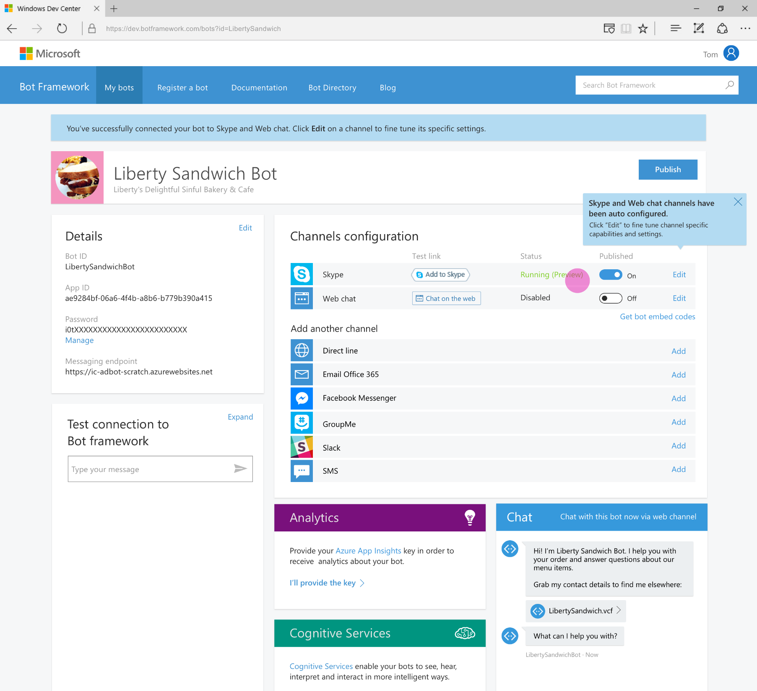
Developer Portal
Register your bot
Connect to channels
Test
Publish
Manage
Measure
Notes:
TODO: replace screenshot

Slide 33
Demo
EchoBot (in Visual Studio Bot Application project template)

Slide 34
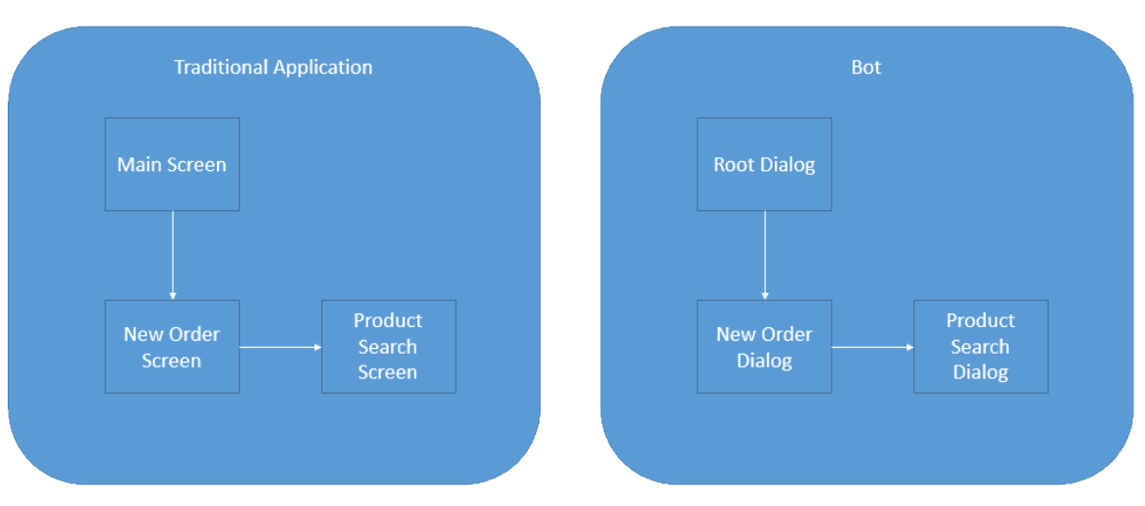
Dialogs are for bots like screens are for apps
They separate concerns and organize flows, exactly the same way:
Read more:
https://docs.microsoft.com/en-us/bot-framework/bot-design-conversation-flow

Slide 35
Invoking a Dialog – C#
public class MessagesController : ApiController
{
public async Task<HttpResponseMessage> Post([FromBody]Activity activity)
{
//controller redirects to RootDialog
await Conversation.SendAsync(activity, () => new RootDialog());

Slide 36
Invoking a Dialog – Node
var server = restify.createServer();
server.listen(process.env.port || process.env.PORT || 3978, function () { });
var connector = new builder.ChatConnector({
appId: process.env.MICROSOFT_APP_ID,
appPassword: process.env.MICROSOFT_APP_PASSWORD
});
var bot = new builder.UniversalBot(connector);
server.post('/api/messages', connector.listen());
// Root dialog
bot.dialog('/', ...

Slide 37
Dialogs are serialized into stacks
Root Dialog
This is how we know how to navigate “back”
Users won’t necessarily think that way
Dialog 1
Dialog 2
…

Slide 38
Redirecting to a Dialog – C#
public virtual async Task MessageReceivedAsync(IDialogContext context, IAwaitable<IMessageActivity> result)
{
var message = await result; //We've got a message!
if (message.Text.ToLower().Contains("order"))
{
//User said 'order'. Let's invoke the New Order Dialog and wait for it to finish
//Then, we will call the ResumeAfterNewOrderDialog
await context.Forward(new NewOrderDialog(), this.ResumeAfterNewOrderDialog, message, CancellationToken.None);
}
//User typed something else so for simplicity we will just ignore
//and keep waiting for the next message
context.Wait(this.MessageReceivedAsync);
}

Slide 39
Redirecting to a Dialog – Node
bot.dialog('/', new builder.IntentDialog()
//Did the user type 'order'?
.matchesAny([/order/i], [
function (session) {
//Let's invoke then the new order dialog
session.beginDialog('/newOrder');
},
function (session, result) {
//This will get us whatever the new order dialog decided to return to us
var resultFromNewOrder = result.response;
session.send('New order dialog just told me this: %s', resultFromNewOrder');
//We are now done with the root dialog
session.endDialog();
}
])

Slide 40


Prompt types
PromptDialog.Attachment()
PromptDialog.Choice()
PromptDialog.Confirm()
PromptDialog.Number()
PromptDialog.Text()

Slide 41
Persisting Data
Bot State Service: https://docs.botframework.com/en-us/csharp/builder/sdkreference/stateapi.html
UserData
Stores information globally for the user across all conversations.
ConversationData
Stores information globally for a single conversation. This data is visible to everyone within the conversation so care should be used to what’s stored there. It’s disabled by default and needs to be enabled using the bots persistConversationData setting.
PrivateConversationData
Stores information globally for a single conversation but its private data for the current user. This data spans all dialogs so it’s useful for storing temporary state that you want cleaned up when the conversation ends.
Notes:
dialogData
Persists information for a single dialog instance. This is essential for storing temporary information in between the steps of a waterfall.

Slide 42
Where is state stored?
The Bot Framework has a default implementation, but you can override it with a custom storage solution if you choose.
IBotState interface in the Bot Connector:
Connector stores data in Azure, encrypted at rest and does not intentionally expire
Emulator provides an in-memory implementation of interface for debugging. This data expires when the emulator process exits.
If you want to store in your datacenters:
Custom IBotState service in the REST layer
Builder interfaces in the language (node or C#) layer
Notes:
https://docs.botframework.com/en-us/technical-faq/#where-is-conversation-state-stored

Slide 43
FormFlow (C# only)
Bot can guide you through wizard-type conversation where user needs to essentially fill out form
Custom prompts for missing information
Validation of inputs
You provide data and it creates the conversation
Asks clarifying questions when needed
Provides navigation between the steps
Notes:
From https://docs.botframework.com/en-us/csharp/builder/sdkreference/forms.html:
At this point, the form is completed and will be returned to the parent dialog. Throughout this interaction you can see that the automatically generated conversation:
Provided clear guidance and help
Understands both numbers and textual entries
Gives feedback on what is understood and what is not.
Asks clarifying questions when needed.
Allows navigating between the steps.
All of this is pretty amazing for not having to do any of the work! However, not every interaction was as good as you might want it to be. That is why there are easy ways to provide:
Messages during the process of filling in a form.
Custom prompts per field.
Templates to use when automatically generating prompts or help.
Terms to match on.
Whether to show choices and numbers or not.
Fields that are optional.
Conditional fields.
Value validation
and much more...

Slide 44
FormFlow: The power of guided conversation
[Describe] Change how a field or a value is shown in a template as a choice or in a card.
[Numeric] Provide limits on the values accepted in a numeric field.
[Optional] Mark a field as optional which means that one choice is not to supply a value.
[Pattern] Define a regular expression to validate a string field.
[Prompt] Define a prompt to use when asking for a field.
[Template] Define a template that is used to generate prompts or values in prompts.
[Terms] Define the input terms that match a field or value.

Slide 45
Demo
Annotated Sandwich Bot

Slide 46
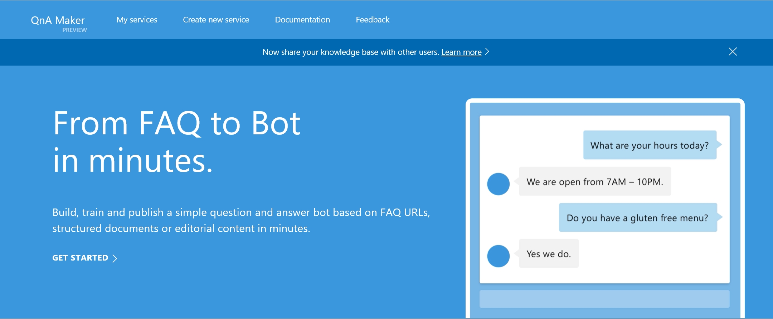
QnA Maker
Autogeneration of conversation logic from FAQ
http://qnamaker.ai
Notes:
https://careers.microsoft.com/help/faq

Slide 47
Scorable Groups
Help with managing working with multiple services: LUIS, QnAMaker, Azure Search, etc.
[RegexPattern("^hello")]
[RegexPattern("^hi")]
[ScorableGroup(0)]
public async Task Hello(IDialogContext context, IActivity activity)
{
await context.PostAsync("Hello! I am a Photo Organization Bot.
I can search your photos, share your photos on Twitter, and
order prints of your photos.");
}

Slide 48
Demo
PictureBot from CognitiveServicesTutorial

Slide 49
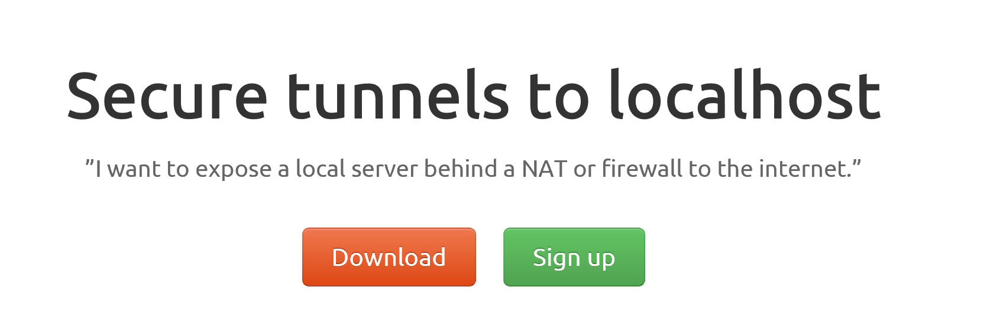
ngrok

Slide 50
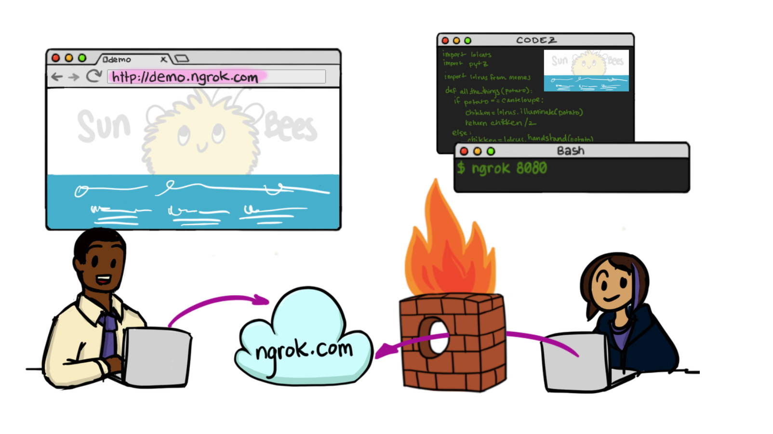

Slide 51
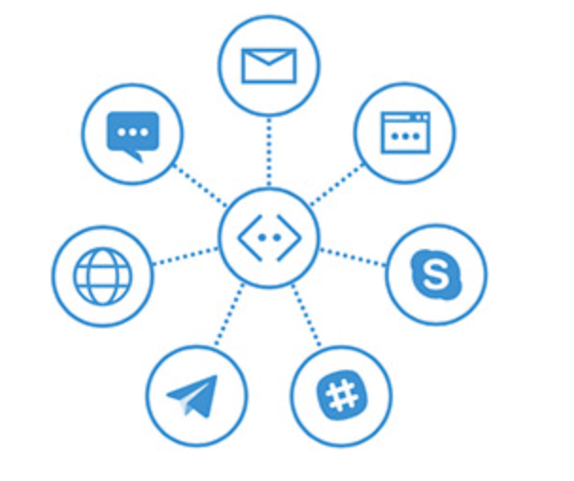
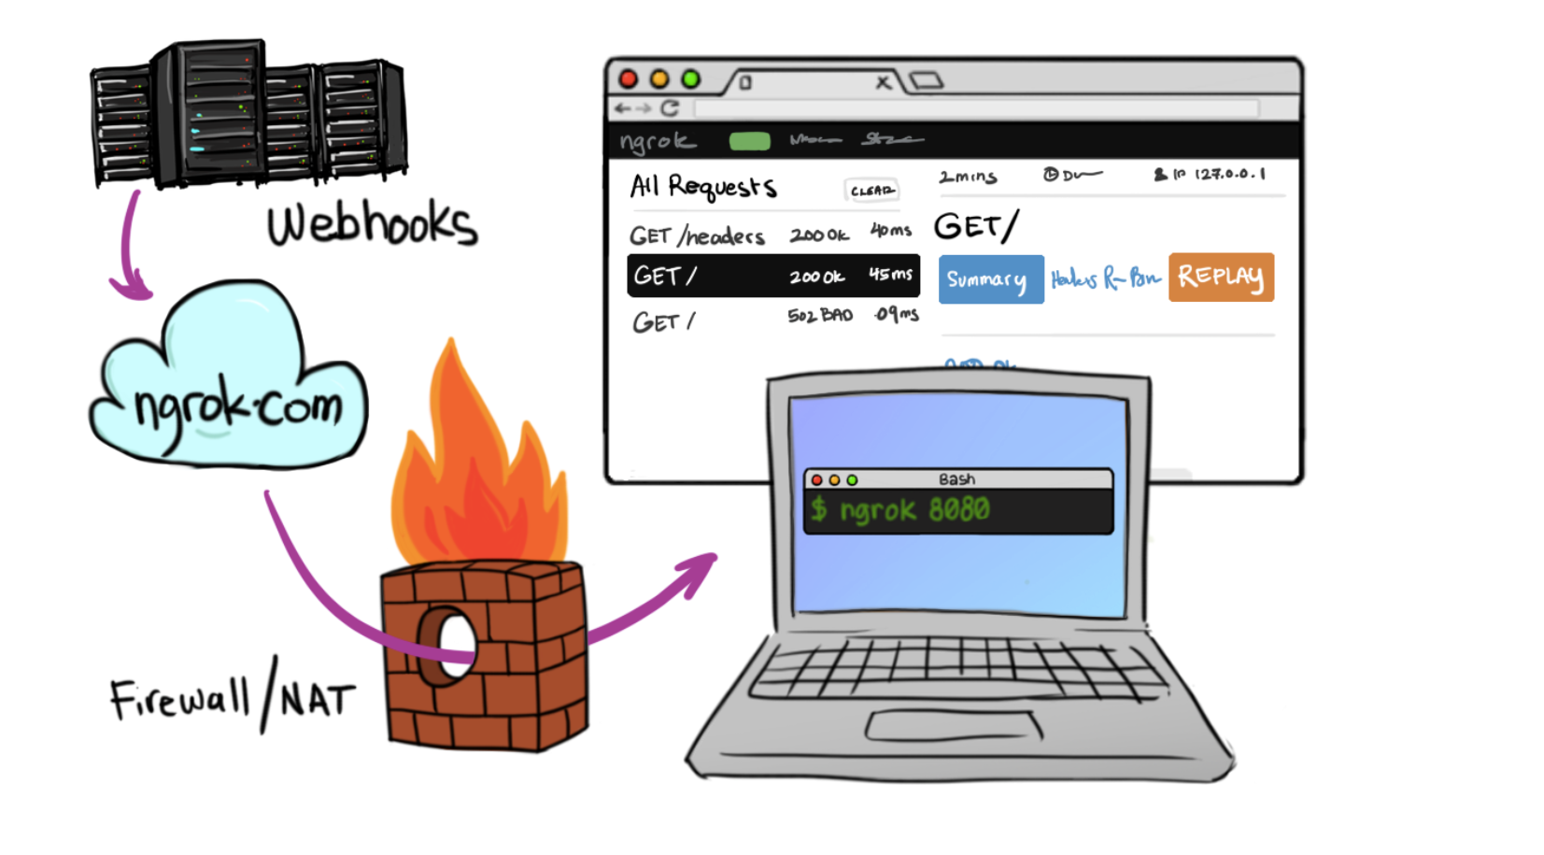
In Cloud
BotFramework

Slide 52
Bot Design
http://aka.ms/botdesign

Slide 53
Build a bot with a clear purpose
What makes a bot great:
It is not how much AI it has
It is not how much natural language it offers
It is not whether it uses voice or not
It’s one thing:
It solves the user’s needs in the quickest/easiest way compared to any other option
...like an app, or a website

Slide 54
Fact #1: New bot developers tend to abuse NLP
A bot with a single dialog using 100 LUIS intents is a bad design:
One question
100 LUIS intents, * 100 different utterances per intent = 10000 different things users may say (plus the other 90000 possibilities you didn’t predict)
100 different things your bot can do
Users will only guess 3 or so
So you just wasted 97% of your code
Hello user! How can I help you?

Slide 55
Fact #1: New bot developers tend to abuse NLP
So instead:
Hello user! How can I help you?
What events are you interested in?
What music would you like? (by the way, next time you could just type “I’m looking for a song named xyz” and I will know what to do)
Events
Music
Stages
Comedy
Amenities
Film
Laser Dome
Spectacles
Guide the user
Save time
Help the user discover what your bot can do
Theater

Slide 56
How LUIS.ai works

Slide 57
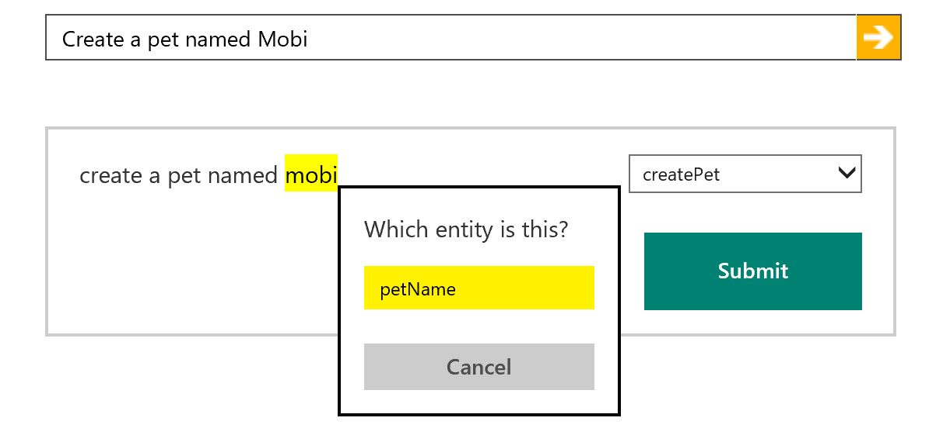
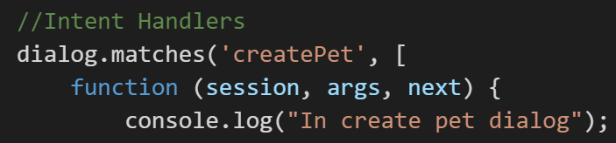
How LUIS.ai works
LUIS.ai
Language Understanding Intelligence Service
Identify entities and intents of messages
Train through GUI or programmatically
Built in LUIS intent handling in bot framework

Slide 58
Important note on LUIS:
If your bot needs 20 LUIS models because of too many intents/entities, then very likely adding 40 won’t fix it. Or 80.
You have a design problem there; brute forcing it won’t help.
Refer to fact #1: New bot developers tend to abuse NLP

Slide 59
Fact #2: Just text or just voice are NOT natural experiences

Slide 60
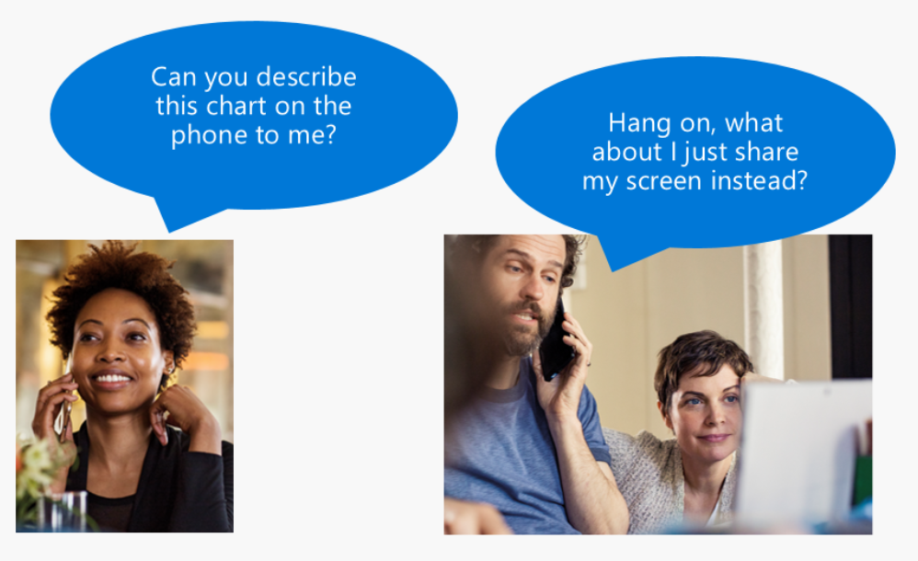
Fact #2: Just text or just voice are NOT natural experiences

Slide 61
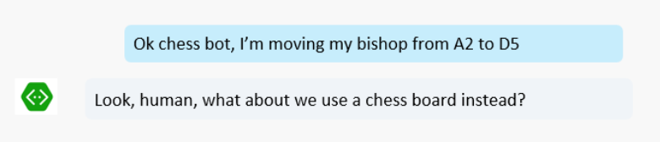
Fact #2: Just text or just voice are NOT natural experiences

Slide 62
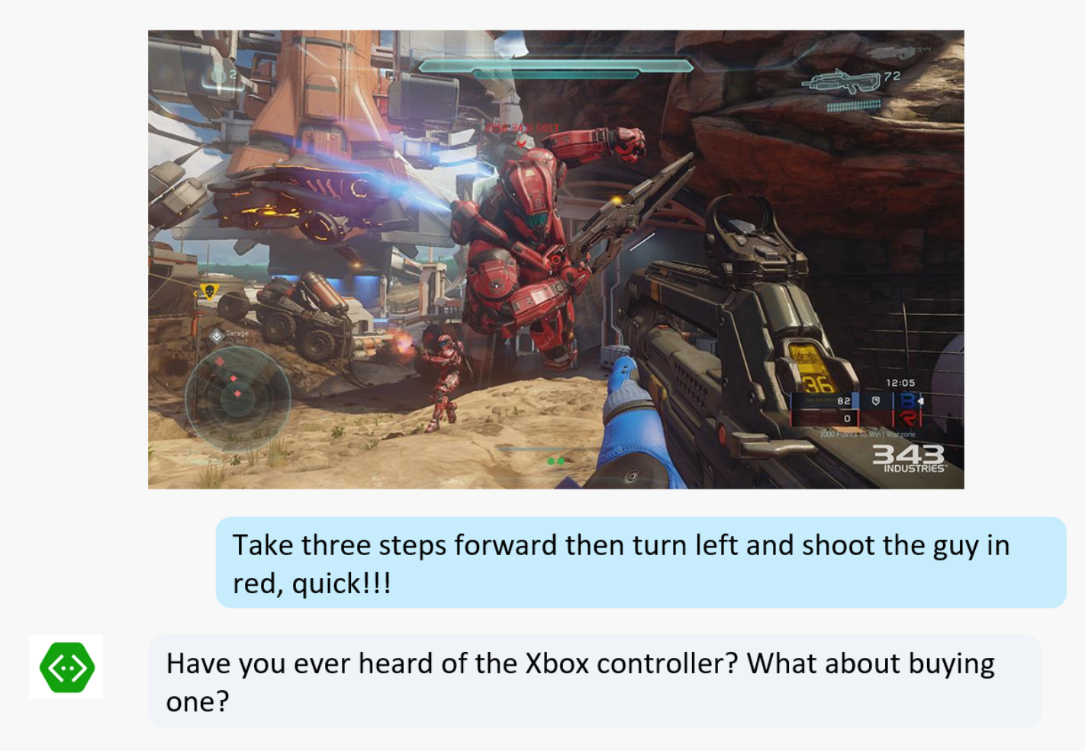
Fact #2: Just text or just voice are NOT natural experiences

Slide 63
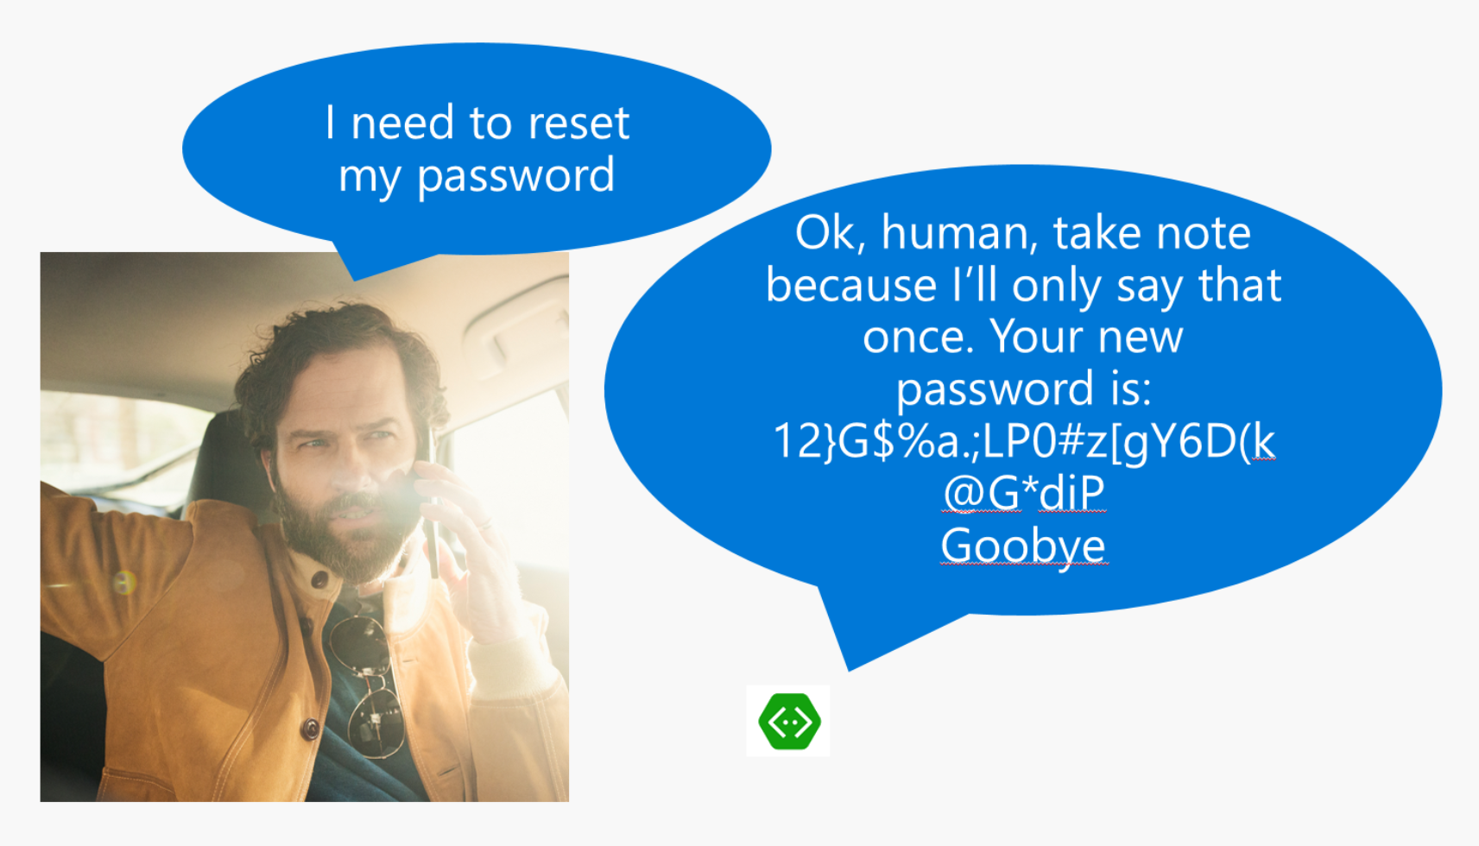
Fact #2: Just text or just voice are NOT natural experiences

Slide 64
Fact #2: Just text or just voice are NOT natural experiences
The world is made of images, movement, sounds, text, symbols, objects… Isolate one and it becomes “unnatural” very quickly.
Again: Focus on the actual user experience. If it feels like it doesn’t make sense, then it probably doesn’t.

Slide 65
Fact #3: Users love buttons
When given the choice of rich controls, text and voice, user will choose:
UI Controls first
Text second
Voice third, only if options above aren’t possible (e.g. Driving a car)

Slide 66
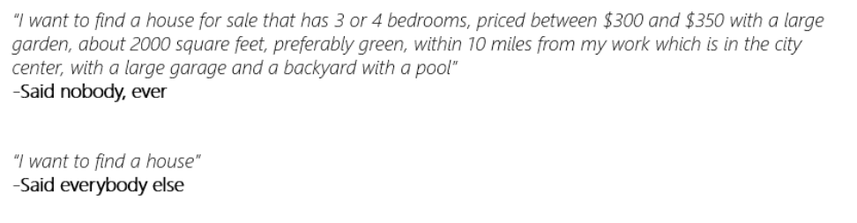
Fact #4: Users never say things the way you expect
As you model your NLP, make sure you’re being realistic.

Slide 67
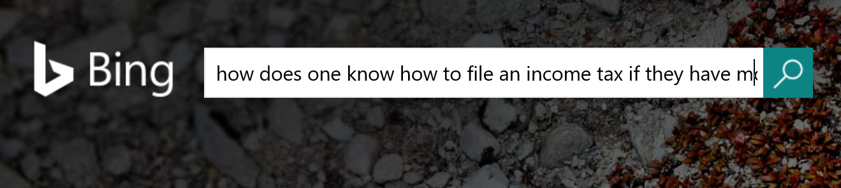
Fact #5: Search can do wonders for bots
Users are often terrible at using search on web
Add search to a bot and now you have a great tool to guide the user into refining their search
Knowledge base, informational, Q&A bots are great scenarios. They typically use QnA Maker and Azure Search for it

Slide 68
Fact #5: Search can do wonders for bots
QnAMaker.ai:
Super low friction way of creating a Q&A bot
Built in web and document crawler: Parses data and builds the QnA easily
Not great for too many records
Not great for deep level customization of the experience
Azure Search:
Can work with millions of records like a breeze
Works with different document formats and data sources
Takes more effort to prepare/code/fine-tune

Slide 69
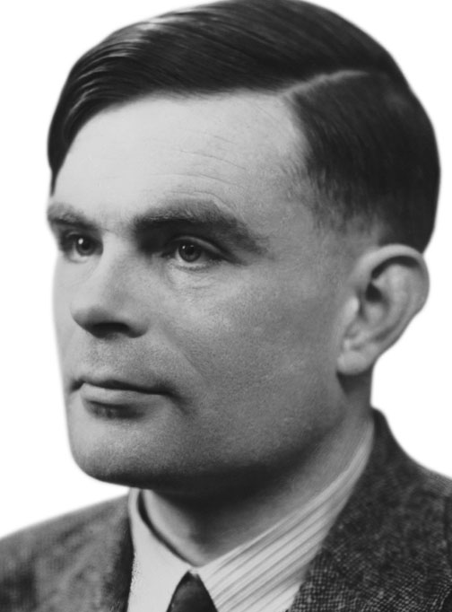
Fact #6: Not all bots need to have conversations
Sometimes buttons do everything you need.
Avoid the engineer’s urge to complicate simple things
Your business requirement is NOT to pass the Turing Test: It is to solve your user’s problem!

Slide 70
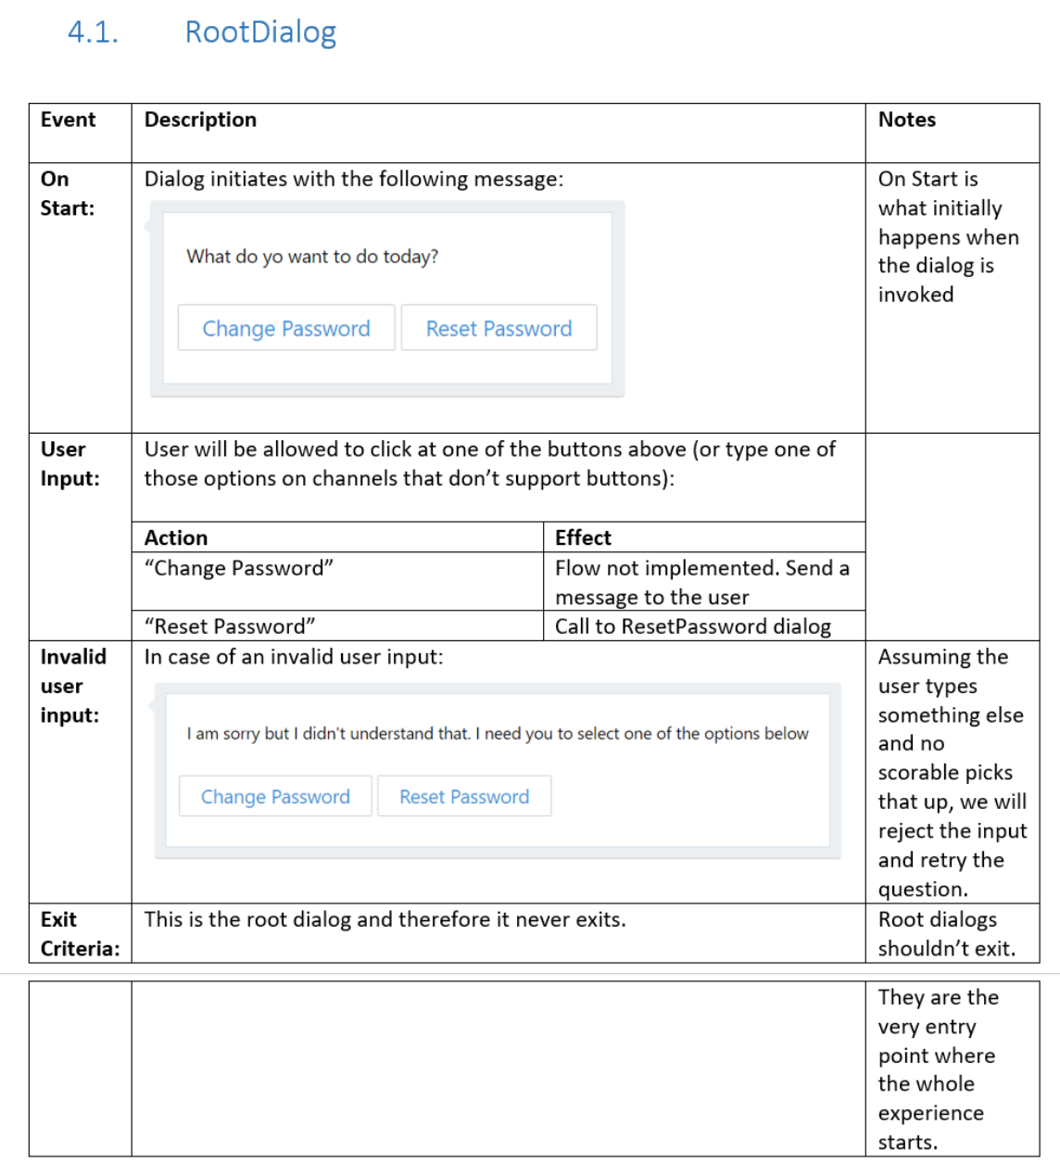
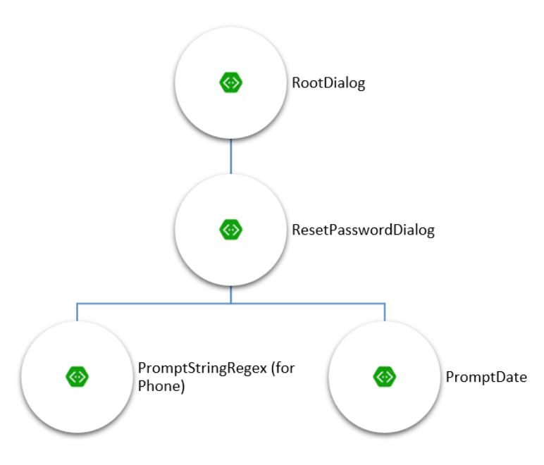
Fact #6: Not all bots need to have conversations
Spec out an “app kind” of bot: https://github.com/MicrosoftDX/botFramework-botSpecDocs/blob/master/src/CaaP%20Design%20spec.docx

Slide 71
Fact #7: No UI is impossible with bots
Even if standard channels can’t do it, you can always build your own UI/App/Web.
Think richer UIs with bots, HoloLens, etc. It is all possible.
Read more:
https://docs.microsoft.com/en-us/bot-framework/bot-design-pattern-embed-app
https://docs.microsoft.com/en-us/bot-framework/bot-design-pattern-embed-web-site

Slide 72
Fact #8: Measurement and logging
If your bot doesn’t collect data and give you ways of understanding what it does well and not, you can’t make it better.
No logging by default
Easy integration with Application Insights

Slide 73
Resources
Developer portal: http://dev.botframework.com
Bot directory: http://bots.botframework.com
Documentation: http://docs.botframework.com
Visual Studio template: http://aka.ms/bf-bc-vstemplate
Bot Framework Emulator: http://emulator.botframework.com
Best sample code: http://aka.ms/JenBotSamples
GitHub repo: http://github.com/Microsoft/BotBuilder

Slide 74
Thank you!
Jennifer Marsman
Principal Software Development Engineer
http://blogs.msdn.microsoft.com/jennifer
Twitter: @JenniferMarsman

Slide 75
Cognitive Services: Making AI Easy
Jennifer Marsman
Principal Software Development Engineer
Microsoft Corporation
http://blogs.msdn.microsoft.com/jennifer
Twitter: @JenniferMarsman

Slide 76
Session Goals
Give you an overview of Cognitive Services (since we won’t be able to hit everything in the hands-on labs)
Understand how Cognitive Services fits into our broader machine learning offerings

Slide 77

Vision
From faces to feelings, allow your apps to understand images and video
Microsoft Cognitive Services
Give your apps a human side
Speech
Hear and speak to your users by filtering noise, identifying speakers, and understanding intent
Language
Process text and learn how to recognize what users want
Knowledge
Tap into rich knowledge amassed from the web, academia, or your own data
Search
Access billions of web pages, images, videos, and news with the power of Bing APIs
Notes:
What are Cognitive Services? Microsoft Cognitive Services are a new collection of intelligence and knowledge APIs that enable developers to ultimately build smarter apps.
We are bringing together Intelligence (Oxford) and Knowledge from the corpus of the web (Bing)
Cognitive = human perception and understanding, enabling your apps to see the world around them, to hear and talk back with the users—to have a human side.
What are Microsoft Cognitive Services?
Microsoft Cognitive Services is a new collection of intelligent APIs that allow systems to see, hear, speak, understand and interpret our needs using natural methods of communication. Developers can use these APIs to make their applications more intelligent, engaging and discoverable. To try Cognitive Services for free, visit www.microsoft.com/cognitive.
With Cognitive Services, developers can easily add intelligent features – such as emotion and sentiment detection, vision and speech recognition, knowledge, search and language understanding – into their applications. The collection will continuously improve, adding new APIs and updating existing ones.
Cognitive Services includes:
Vision: From faces to feelings, allow apps to understand images and video
Speech: Hear and speak to users by filtering noise, identifying speakers, and understanding intent
Language: Process text and learn how to recognize what users want
Knowledge: Tap into rich knowledge amassed from the web, academia, or your own data
Search: Access billions of web pages, images, videos, and news with the power of Bing APIs

Slide 78









Why Microsoft Cognitive Services?
Easy
Flexible
Tested
Roll your own with REST APIs
Simple to add: just a few lines of code required
Integrate into the language and platform of your choice
Breadth of offerings helps you find the right API for your app
Built by experts in their field from Microsoft Research, Bing, and Azure Machine Learning
Quality documentation, sample code, and community support
GET A KEY
BUILD
Notes:
Why choose these APIs? They work, and it’s easy.
Easy: The APIs are easy to implement because of the simple REST calls. Being REST APIs, there’s a common way to implement and you can get started with all of them for free simply by going to one place, one website, www.microsoft.com/cognitive. (You don’t have to hunt around to different places.)
Flexible: We’ve got a breadth of intelligence and knowledge APIs so developers will be able to find what intelligence feature they need; and importantly, they all work on whatever language, framework, or platform developers choose. So, devs can integrated into their apps—iOS, Android, Windows—using their own tools they know and love (such as python or node.js, etc.).
Tested: Tap into an ever-growing collection of powerful AI algorithms developed by experts. Developers can trust the quality and expertise build into each API by experts in their field from Microsoft’s Research organization, Bing, and Azure machine learning and these capabilities are used across many Microsoft first party products such as Cortana, Bing and Skype.

Slide 79
Scenarios
Emotion detection at retail displays
Facial identification to find missing children
Sentiment analysis to learn how customers feel
Facial detection to calculate the male/female ratio at a nightclub
Language understanding to allow automated support bots to understand natural language
Object recognition to enable a blind person to read a menu
Notes:
I will be speaking on the Microsoft Cognitive Services. The Cognitive Services are a set of APIs that provide cognitive functionality like object recognition, emotion detection, facial identification, speech understanding, sentiment analysis, text analytics, and more. Previously, you would need advanced knowledge of machine learning in order to perform such tasks. But Microsoft Research has used powerful machine learning algorithms to solve these commonly-used scenarios, and make them available with a simple API call. For example, you can send a picture to our facial detection API, and we will return age, gender, head pose, smile, facial hair information, facial bounding box, and 27 landmarks for each face in the image.
Imagine the scenarios this enables! In retail or at a trade show, a company could use emotion detection to see how people are reacting to their products. Facial identification could be used to find missing children quickly at an amusement park. The facial APIs could determine the male/female ratio at a nightclub, as well as identifying VIP guests or banned guests. The language understanding service can allow automated support bots to understand natural language. The object recognition capabilities can enable a blind person to read a menu in a restaurant or have his surroundings described to him.

Slide 80


“Thousands of partners sign in to our platform every hour. The response time from the Face API is incredible, enabling us to verify our drivers without slowing them down.”
Dima Kovalev, Product Manager, Uber
Face API
Read Case Study Here

Slide 81

How do I use them?
using Microsoft.ProjectOxford.Vision;
using Microsoft.ProjectOxford.Vision.Contract;
AnalysisResult analysisResult;
var features = new VisualFeature[] { VisualFeature.Tags, VisualFeature.Description };
using (var fs = new FileStream(@"C:\Vision\Sample.jpg", FileMode.Open))
{
analysisResult = await visionClient.AnalyzeImageAsync(fs, features);
}
{
"tags": [
{ "name": "outdoor",
"score": 0.976 },
{ "name": "bird",
"score": 0.95 } ],
"description":
{ "tags":
[ "outdoor", "bird" ],
"captions": [
{ "text": "partridge
in a pear tree",
"confidence": 0.96 }
]
}
}
POST https://api.projectoxford.ai/vision/v1.0/analyze?visualFeatures=Description,Tags
&subscription-key=<Your subscription key>
Notes:
This example is calling Vision API to get tags and description.
https://www.microsoft.com/cognitive-services/en-us/computer-vision-api/documentation/HowToCallVisionAPI
POST https://api.projectoxford.ai/vision/v1.0/analyze?visualFeatures=Description,Tags&subscription-key=<Your subscription key>
Security: can do this without subscription key in the URL (in header instead)

Slide 82
Vision

Slide 83
Vision
Computer Vision API
Face API
Emotion API
Video API
Distill actionable information from images
Detect, identify, analyze, organize, and tag faces in photos
Personalize experiences with emotion recognition
Analyze, edit, and process videos within your app
Notes:
Vision
Computer Vision API: as a free trial on the website microsoft.com/cognitive. There are also SDKs and Samples available on GitHub or through NuGet, Maven, and Cocoapods for select platforms to make development easier. It’s important to note here that it’s not client side running code, but light wrappers around the REST calls to make integration easy.
A photo app would use this as a way to tag user photos and make it easier for users to search through their collections. An assistive app would use this as a way to describe the surroundings to visually-impaired users. Works really well on both indoor or outdoor images; it can recognize common household objects, and it can describe outdoor scenes. However, we did not train on aerial images (say from drones), or on many close ups (so pictures where we zoomed in extremely on the subject won't do well). We also do really well recognizing celebrities (as long as most of the face is visible, and they were facing the camera).
Face API: Some potential uses for this technology include facial login, photo tagging, and home monitoring. Or attribute detection to know age, gender, facial hair, etc.
Emotion API: is available in the Azure marketplace, as a free trial on the website microsoft.com/cognitive. See Computer Vision description.
Build an app that responds to moods. Using facial expressions, this cloud-based API can detect happiness, neutrality, sadness, contempt, anger, disgust, fear, and surprise. The AI understands these emotions based on universal facial expressions, and it functions cross-culturally, so your app will work around the world. Some use cases would be an advertising company wants to test user response to an ad, a tv studio wants to track responses to a pilot.
Video API: as a free trial on the website microsoft.com/cognitive. See Computer Vision description.
It brings Microsoft state of the art video processing algorithms to developers. With Video API, developers can analyze and automatically edit videos, including stabilize videos, create motion thumbnails, track faces, and detect motion. Use cases: For Stabilization: If you have multiple action videos, you can use the stabilization algorithm to make them less shaky and easier to watch. You can also use the stabilization algorithm as a first step in performing other video APIs. For Face Tracking: You can track faces in a video to do A/B testing in a retail setting. You can combine Video API Face Tracking with capabilities in Face API to search through surveillance, crime, or media footage to look for certain person. For Motion Detection: Instead of having to watch long clips of surveillance footage, the API will let you know what time motion occurred and its duration. For Video Thumbnail: Take a long video, such as a keynote presentation, and automatically create a short preview clip of the talk. For Face Tracking: Works best for frontal faces. Currently cannot detect small faces, side or partial faces. For Motion Detection: Detects motion on a stationary background (e.g. fixed camera). Current limitations of the algorithms include night vision videos, semi-transparent objects, and small objects. For Video Thumbnail: Take a long video, such as a keynote presentation, and automatically create a short preview clip of the talk.

Slide 84
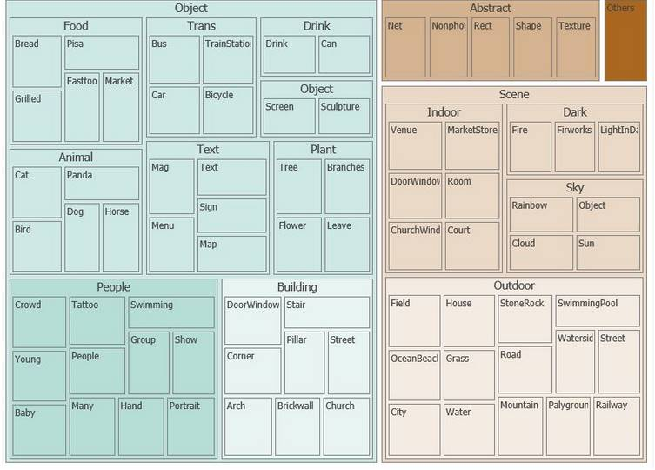
Computer Vision: 86 Categories
Notes:
Image from https://www.microsoft.com/cognitive-services/en-us/computer-vision-api/documentation/analyzeimage
Text at https://www.microsoft.com/cognitive-services/en-us/computer-vision-api/documentation/Images/86categories

Slide 85
Data
Computer Vision
Description, tags, clip art, line drawing, black & white, IsAdultContent/Score, IsRacy/Score, categories, faces, dominant colors, accent color
https://www.microsoft.com/cognitive-services/en-us/computer-vision-api
Emotions
Anger, contempt, disgust, fear, happiness, sadness, surprise, and neutral
https://www.microsoft.com/cognitive-services/en-us/emotion-api
Face
Bounding box, 27 facial landmarks, age, gender, head pose, smile, facial hair, glasses
https://www.microsoft.com/cognitive-services/en-us/face-api

Slide 86
Best Practices for Devs
Samples & SDKs exist
For ObjectiveC/Swift/iOS, Java/Android, C#/Windows, and Python (Jupyter notebook)
https://www.microsoft.com/cognitive-services/en-us/SDK-Sample?api=computer%20vision
Constraints
Computer Vision API describes images in English only
Face API detects up to 64 human faces in one image
Facial detection: JPEG, PNG, GIF (first frame), and BMP supported, image file size of 1KB-4MB, detectable face size 36x36-4096x4096 pixels, returned faces ordered by face rect size desc
Fun random details
FindSimilarFace has 2 modes: matchPerson (default, same person) and matchFace (similar faces)
FaceGroup API takes between 2-1000 candidate faces
Documentation: https://www.microsoft.com/cognitive-services/en-us/documentation
Notes:
Facial detection constraints and excellent documentation at https://dev.projectoxford.ai/docs/services/563879b61984550e40cbbe8d/operations/563879b61984550f30395236

Slide 87
Demo
Website JSON: http://microsoft.com/cognitive
Deal With It Bot – Face API: http://aifunclub.azurewebsites.net
Intelligent Kiosk – Face and Emotion API:
https://github.com/Microsoft/Cognitive-Samples-IntelligentKiosk
Notes:
http://www.kcconfidential.com/wp-content/uploads/2013/08/orange-is-the-new-black-cast-2.jpg
http://i.huffpost.com/gen/2364914/images/o-GRUMPY-CAT-facebook.jpg
https://pbs.twimg.com/media/CsgiyNWVYAACAG-.jpg:large

Slide 88
Speech

Slide 89
Speech
Vision
Bing Speech API
Speaker Recognition API
Custom Recognition Intelligent Service
Convert speech to text and back again, and understand its intent
Give your app the ability to know who's talking
Fine-tune speech recognition for anyone, anywhere

Slide 90
Demo
Speech API
Speaker Recognition API
http://microsoft.com/cognitive
Notes:
Use Edge.
Speech to Text: Four score and seven years ago, our forefathers brought forth on this continent, …
Text to Speech: How may I serve you, Khaleesi?
Speaker Recognition: President demo

Slide 91
Language

Slide 92




Speech
Language
Bing Spell Check API
Web Language Model API
Linguistic Analysis API
Language Understanding Intelligent Service
Text Analytics API
Detect and correct spelling mistakes within your app
Leverage the power of language models trained on web-scale data
Easily parse complex text with language analysis
Teach your apps to understand commands from your users
Detect sentiment, key phrases, topics, and language from your text
Notes:
Bing Spell Check API: Microsoft’s state-of-the-art cloud-based spelling algorithms to detect a wide variety of spelling errors and provide accurate suggestions. Using Bing Spell Check, your mobile and PC apps will be powered with state-of-the-art spelling capabilities. Our service is trained on a massive corpus of data gleaned from billions of web pages. There is no need to train your own models. The speller model is updated regularly and incorporates new terms and brands almost as quickly as they appear on the web. This API is available through Microsoft Cognitive Services for customers with low-volume and high-latency jobs. For high-volume and low-latency we have an internal API which may be more suitable.
Use cases: 1) Improve the quality of a website's product search 2) provide spell correction for a keyboard app 3) provide spell correction for text fields in an app or web page 4) detect errors in UI text and user data. See https://blogs.msdn.microsoft.com/msr_er/2010/12/15/building-a-better-speller-bing-and-microsoft-research-offer-prizes-for-best-search-engine-spelling-alteration-services/ The speller is exceptional at common spelling errors with low edit-distance (such as febuary->February) but a lot of other spellers are good at that as well. We Do a very good job with word breaking, proper names in context (try "director stephen spielberg") and fictional character names, just a few examples. Areas that are a challenge are capitalization (we don't know what to do with "March" for example, even with context) and consistency (there are times when we will flag a word only intermittently based on the context).
Web Language Model API: Web Language API indexes the web and Bing queries to allow users to calculate the probabilities of natural language expressions and estimate a list of most likely words to follow an existing sequence of words. Use this API to insert spaces into a string of words without spaces, like a hashtag or URL. Use this API to rerank machine translation/speech recognition candidate sentences based on probability of the sentence.
Use this API for academic research. http://research.microsoft.com/apps/pubs/default.aspx?id=130762
We also have SDKs available for WebLM
Linguistic Analysis API: The Linguistic Analysis API helps you gain insights from text. Given a natural language parse, it’s easy to identify the concepts and entities (noun phrases), actions (verbs and verb phrases), descriptive words, and more. The processed text can provide useful features for classification tasks such as sentiment analysis.
We also have SDKs available for Linguistic Analysis.
LUIS: Language Understanding Intelligent Service (LUIS) allows developers to build a model that understands natural language and commands tailored to their application. Example: You can say “turn down the thermostat in the living room,” send it to a LUIS model, and instead of just returning the text that represents what was said, LUIS will return: the action is “turn down,” the location is “living room,” and the target is “thermostat.” LUIS allows developers to iteratively build on these models and take speech or text input and return a structured representation of what the person said. Not only that but by build LUIS will help developers create and train smart conversational bot (Intercom or Slack) with a single button. LUIS will also offer action fulfillment capabilities by simple integration with webhooks. LUIS works pretty well it comes to intents. For the entities, the learning curve is slower especially when the number of entities increases. LUIS only supports 20 intents & 10 entities yet by build each entities can have up to 10 children.

Slide 93

Text analytics
Sentiment analysis Understand if a record has positive or negative sentiment
Key phrase extraction Extract key phrases from a piece of text, and retrieve topics
Topic detection Use clustering techniques to identify the trending topics on a large set of text records
Language detection Identify the language, 120 supported languages

Slide 94
Text analytics
Sentiment analysis English, Spanish, French, and Portuguese Understand if a record has positive or negative sentiment
Key phrase extraction English, Spanish, German, and Japanese Extract key phrases from a piece of text, and retrieve topics
Topic detection English Use clustering techniques to identify the trending topics on a large set of text records
Language detection Identify the language, 120 supported languages
Notes:
https://azure.microsoft.com/en-us/documentation/articles/cognitive-services-text-analytics-quick-start/

Slide 95
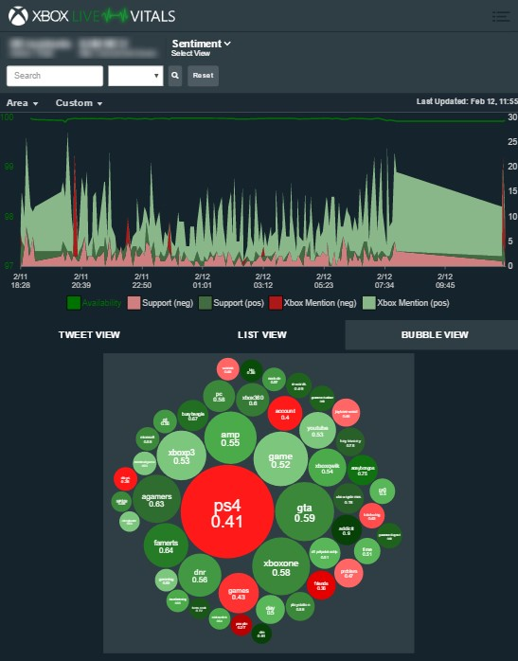
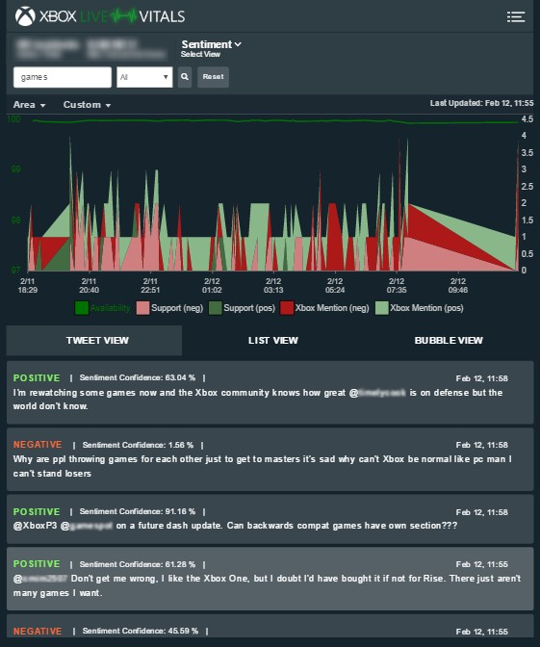
XBOX Live Vitals
Twitter data sent to @XboxSupport
Text Analytics API
Language detection
Key phrase extraction
Sentiment analysis
December 25, 2016:
Red “code” bubble

Slide 96
Demo
Text Analytics
http://text-analytics-demo.azurewebsites.net
Unconscious Bias app
http://aka.ms/bias

Slide 97
Language Understanding (LUIS)
Define entities and intents
Entities – DepartureCity, ArrivalCity, DepartureDate, ReturnDate
Intents – book a flight, check in for a flight, cancel a flight
Map some utterances to an intent
Examples: “I want to go to Paris from Sept 25 to Sept 29, 2016”, “Book me a flight from DTW to CDG leaving on 9/25/2016 and returning 9/28/2016”, etc.
Help your model improve over time based on real feedback
See what real users are sending to your model, and map those utterances to intents (or create new intents based on what your users are asking).

Slide 98
Demo
Microsoft Career Bot
http://microsoftcareerbot.azurewebsites.net
http://luis.ai

Slide 99
Knowledge

Slide 100

Language
Knowledge
Academic Knowledge API
Knowledge Exploration Service
Entity Linking Service
Recommendations API
Explore relationships among academic papers, journals, and authors
Add interactive search over structured data to your project
Contextually extend knowledge of people, locations, and events
Provide personalized product recommendations for your customers
Notes:
Academic Knowledge API: The Academic Knowledge API enable developers to interpret user queries for academic intent and retrieve rich entity information about research papers, authors, journals, conferences, and universities from the Microsoft Academic Graph (MAG). 1. Developers can use this API to build search features such as the knowledge-based query auto-suggest and search results at http://academic.microsoft.com. 2. Universities can retrieve analytics data about their researchers' publications, topics, and venues. 3. Conference organizers can analyze the citation patterns of their conference papers. 4. Data scientists and computer science researchers can develop new ranking and analysis approaches over a large heterogeneous network.
A publication about our approach can be found here: http://research.microsoft.com/apps/pubs/default.aspx?id=246609 The underlying data graph (Microsoft Academic Graph) is constructed over discovered academic papers on the web. The data is largely unstructured, of variable quality, and ambiguous. We are constantly working to improve this data quality and to correctly aggregate the multiple instances of authors, papers, etc. into a single representative entity in the graph.
Knowledge Exploration Service API: Enable interactive search experience over structured data via natural language. Indexes customer's structured data (BYOD) with support for prefix completion. Generates annotated interpretations/completions of natural language queries. Publishers/libraries can use this to create interactive search over their publications similar to academic.microsoft.com. Merchants can create interactive search experience to help users find and discover products. Data owners can create systems that answer natural language user questions. It works best when the structured data is clean and the natural language structure is simple and predictable. Otherwise, customers will have to invest a bit of work to generate the structured data and author the grammar. We are working on future components to simplify both authoring aspects.
Entity Linking Service API: Given a specific paragraph of text within a document, the Entity Linking will recognize and identify each separate entity based on the context and linking the entity to wikipedia. Use cases: A news agency would use this to analysis their news article to create relations between articles, a news agency would use this to generate tags for article and make recommendation for reader, a company would use this to track the PR articles mentioned it and product comments to track customer feedback. We also have SDKs available for Entity Linking.

Slide 101
Search

Slide 102
Search
Knowledge
Bing Web Search API
Bing Autosuggest API
Bing Image Search API
Bing Video Search API
Bing News Search API
Connect powerful search to your apps
Give your app intelligent autosuggest options for searches
Bring advanced image and metadata search to your app
Trending videos, detailed metadata, and rich results
Link your users to robust and timely news searches
Notes:
The Search APIs provide access to the search technology that power Bing.com and a long list of 1st-party (Office, Cortana, Xbox, Edge) and 3rd-party (AOL, Apple, Amazon, Yahoo etc.) partners. In total, we have 4 Search APIs for web, image, video and news search. In addition we provide access to our Autosuggest (type-ahead) and Spell Check services.
Bing Web Search API: is the main Search API. With one programmatic call, the user can get back relevant webpage, image, video, and news results. It's equivalent to searching in the web vertical in bing.com. The Search APIs provide the power of the Bing Search engine to developers. You get access to many of the latest and greatest capabilities the bing.com site has to offer, in the form of an API. It's the same architecture stack so it's a powerful way to bring the knowledge and intelligence of the search engine to your own experience. The API is built directly on top of the entire Bing stack- you get the quality, relevance, performance and continuous improvements that the rest of the site gets. Similar to Bing.com- tail queries, or obscure terms may have limited results. We're always working to improve the edge cases though and API users will benefit from that.

Slide 103
Demo
Project Murphy Bot
http://projectmurphy.net

Slide 104

Bringing it all together
The Seeing AI App
Computer Vision, Image, Speech Recognition, NLP, and ML from Microsoft Cognitive Services
Read Blog Here
Watch Video Here
Notes:
Here’s a preview of the Seeing AI app, which started as a research project that helps people who are visually impaired or blind to understand who and what is around them.
The app will use computer vision, image & speech recognition, natural language processing and machine learning from Microsoft Cognitive Services. The app is under development and is not available today but it shows what’s possible with the APIs.

Slide 105

Seeing AI

Slide 106


“I have not seen anything comparable. We can use the Computer Vision API to prove to our clients the reliability of the data, so they can be confident making important business decisions based on that information.”
Vigiglobe CEO Leendert de Voogd
Computer Vision API
Read Case Study Here
Notes:
Vigiglobe
Vigiglobe saw an opportunity to analyze not only what was being said on social media, but also the context in which it was being discussed. The team created proprietary algorithms to accurately interpret and contextualize social media messages in real time. Using the Computer Vision API of Microsoft

Slide 107


“Microsoft Cognitive Services gives us a huge range of opportunities. It’s a perfect match for us now, and in the future when we want to add more features to our app. The Computer Vision and Speech APIs are extremely powerful.”
Blucup CEO Jaan Apajalahti
Computer Vision API and Speech API
Read Case Study Here
Notes:
Blucup
Finland-based Blucup was on a mission to solve a common problem: how can salespeople capture data while on the go? The company developed the Zero Keyboard app, which sales reps could use to record customer information quickly and add it automatically to their customer relationship management (CRM) systems using touch gestures, voice, and pictures. Using the Speech and Computer Vision APIs from Microsoft Cognitive Services, Blucup provides customers with accurate results and rich features—all while speeding development internally.

Slide 108
Preview Pricing
https://www.microsoft.com/cognitive-services/en-us/pricing
Documentation
https://www.microsoft.com/cognitive-services/en-us/computer-vision-api/documentation
Client SDKs and Samples
https://www.microsoft.com/cognitive-services/en-us/sdk-sample
​​​
Join Our Community
https://stackoverflow.com/questions/tagged/microsoft-cognitive
https://social.msdn.microsoft.com/forums/azure/en-US/home?forum=mlapi
https://cognitive.uservoice.com/
Developer Resources
Notes:
Pricing – preview pricing is subject to change; free tier available
Access to strong documentation, sample code and community resources is critical for developers to be able to understand and become users of Cognitive Services. Customize these links based on your own resources or use the ones listed here.

Slide 109

Get started for free at microsoft.com/cognitive

Slide 110
Thank you
Jennifer Marsman
Principal Software Development Engineer
Microsoft Corporation
http://blogs.msdn.microsoft.com/jennifer
Twitter: @JenniferMarsman

Slide 113
Cognitive Apps Using Document DB
Mike Lanzetta
Principal SDE

Slide 114
Scenario
Intelligence from Images
Vision Services
Cloud Storage
Search
Conversation and Language Understanding

Slide 115
Elastically scalable storage
Independently scale storage and throughput
No partition management
Automatically indexed SSD storage
Global distribution across Azure regions

Slide 116
Schema-agnostic databases – a beautiful thing
{
"ItemType": "Coffee Mug",
"Name": "Geek Mug",
"Color": "Graphite",
"Capacity": {
"value": 16,
"units": "oz"
},
"Microwave-Safe": "yes",
"Dishwasher-Safe": yes"
}
{
"ItemType": "Laptop",
"Name": "Surface Book",
"Processor": [
"2.4 GHz Core i5-6300U",
"3.4 GHz Core i7-6600U"
],
"Memory": [ "8GB", "16GB" ],
"Storage": {
"Type": "SSD"
"Capacity": [ 128, 256, 512, 1024 ]
}
}

Slide 117
Collections != Tables
Collections do NOT enforce schema
Co-locate multiple types in a collection
Annotate documents with a "type" property

Slide 118
Rich SQL and JavaScript queries
No impedance mismatch
Query with SQL and JavaScript
Write business logic entirely in JavaScript with stored procedures and triggers

Slide 119
Consistency Levels
Strong, Eventual, Bounded Staleness, and Session
LEFT TO RIGHT → Weaker Consistency, Better Read scalability, Lower write latency
Strong
Bounded Staleness
Session
Eventual
Client
Client
Client
Client
Client
P
S
S
P
S
S
P
S
S
P
S
S
Consistent Prefix reads.
Reads lag behind writes by K prefixes or T interval
Monotonic reads, writes and Read your writes guarantee

Slide 120

Modeling Data: The Relational Way
Person
PersonContactDetailLnk
ContactDetail
Id
PersonId
Id
ContactDetailId
Address
ContactDetailType
Id
Id

Slide 121
Modeling Data: The Document Way
{ "id": "0ec1ab0c-de08-4e42-a429-...",
"addresses": [
{ "street": "1 Redmond Way",
"city": "Redmond", "state": "WA",
"zip": 98052}
],
"contactDetails": [
{"type": "home", "detail": “555-1212"},
{"type": "email", "detail": “me@ms.com"}
],
...
}
Person
Id
Addresses
Address
…
Address
…
ContactDetails
ContactDetail
…

Slide 122
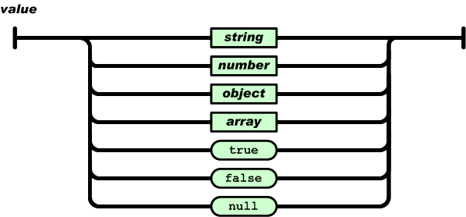


Documents as Trees
JavaScript Object Literals
JSON serializable values (aka JSON Infoset)
{
"locations":
[
{ "country": "Germany", "city": "Berlin" },
{ "country": "France", "city": "Paris" }
],
"headquarter": "Belgium",
"exports":[{ "city": "Moscow" },{ "city": "Athens"}]
};
locations
headquarter
exports
0
1
Belgium
0
1
country
city
country
city
city
city
Germany
Berlin
France
Paris
Moscow
Athens
JSON document as tree
Notes:
Databases vary in their commitment to JSON data model
Relational stores – Require schema, indices & OR mapping; great query
Key-Value stores – Schema-free; values are opaque; poor query
DocumentDB - Deep commitment to the JSON data model & JavaScript directly within the database engine
Automatic indexing of documents without requiring schema or secondary indices
SQL query dialect rooted in JSON; extensible via JavaScript
Efficient execution of application logic with (JavaScript) language integrated database transactions
Minimal impedance mismatch between the programming languages and the database type systems

Slide 123
Query
SELECT C.locations
FROM company C
WHERE C.headquarter = "Belgium"
function businessLogic() {
var country = "Belgium";
__.filter(function(x){return x.headquarter===country;});}
SQL
JavaScript
{ "locations":
[ { "country": "Germany", "city": "Berlin" },
{ "country": "France", "city": "Paris" }
],
"headquarter": "Belgium",
"exports": [{ "city": "Moscow" }, { "city": "Athens" }]
};
{ "locations": [{ "country": "Germany", "city": "Bonn", "revenue": 200 } ],
"headquarter": "Italy",
"exports": [ { "city": "Berlin","dealers": [{"name": "Hans"}] }, { "city": "Athens" }
]
};
locations
locations
headquarter
exports
headquarter
exports
0
Italy
0
1
0
1
Belgium
0
1
country
city
country
city
city
country
city
revenue
city
dealers
city
city
Germany
Bonn
200
Berlin
0
Athens
Germany
Berlin
France
Paris
Moscow
Athens
Input documents
name
{
"results":
[
{
"locations":
[
{"country":"Germany","city":"Berlin"},
{"country":"France","city":"Paris"}
]
}
]
}
Hans
results
0
locations
0
1
country
city
country
city
Query result
Berlin
Paris
Germany
France

Slide 124
Demo

Slide 125
DocumentDB Documents – Just POCOs
public class ImageMetadata
{
public ImageMetadata()
{
}
[JsonProperty(PropertyName = "id")]
public string Id { get; set; }

Slide 126
Querying Documents
λ .\bin\Debug\TestCLI.exe -settings my_settings.json -query "select * from images“
…
{"id":"Analysis_9.jpg","BlobUri":"https://milanzaiworkshop.blob.core.windows.net:443/images/Analysis_9.jpg","LocalFilePath":"F:\\dev\\data\\sample_images\\Analysis_9.jpg","FileName":"Analysis_9.jpg","Caption":"a close up of a doughnut","Tags":["food","bread","snack food"],"NumFaces":0,"Faces":[]}

